Slide 1

Cs 429:DATA MINING Lecture 10
Instructor:
Osama Ahmed Khan
osamaahmedkhan
Jul 6th, 2017

Slide 2
Algorithms
Inferring Rudimentary Rules
Statistical Modeling
Divide-and-Conquer: Constructing Decision Trees
Covering Algorithms: Constructing Rules
Mining Association Rules
Linear Models
Instance-Based Learning
Clustering

Slide 3
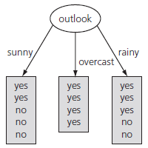
Divide-and-Conquer: Constructing Decision Trees
Weather Forecast Problem 1

Slide 4
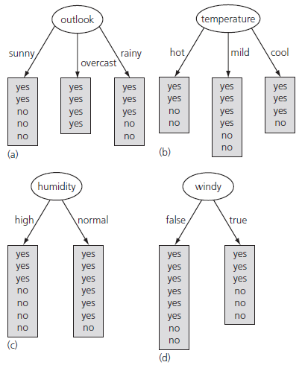
Divide-and-Conquer: Constructing Decision Trees

Slide 5
Divide-and-Conquer: Constructing Decision Trees
Information:
Associated with a node of the tree
Measure of purity, required to predict class for a new instance
The instance should be reaching the node
The smaller the better
Units: bits
Information Gain
Difference of Information between two nodes
Informational value of creating a branch on the attribute node
The larger the better

Slide 6

Divide-and-Conquer: Constructing Decision Trees
Information:
info([2,3]) = 0.971 bits
info([4,0]) = 0.0 bits
info([3,2]) = 0.971 bits
info([x,y)] = info([y,x])
Average Information:

Slide 7
Divide-and-Conquer: Constructing Decision Trees
Class Information:
info([9,5]) = 0.940 bits
Information Gain:
gain(outlook) = info([9,5]) – info([2,3],[4,0],[3,2])
= 0.940 – 0.693 = 0.247 bits
gain(temperature) = 0.029 bits
gain(humidity) = 0.152 bits
gain(windy) = 0.048 bits

Slide 8
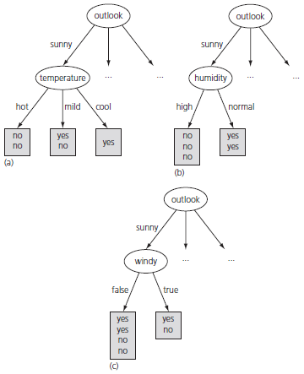
Divide-and-Conquer: Constructing Decision Trees

Slide 9
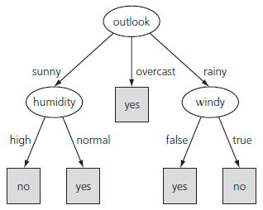
Divide-and-Conquer: Constructing Decision Trees
gain(temperature) = 0.571 bits
gain(humidity) = 0.971 bits
gain(windy) = 0.020 bits

Slide 10
Divide-and-Conquer: Constructing Decision Trees
Information Properties:
When the number of either of the two class labels is zero, info = 0 (minimum or best)
When the number of all of the class labels is equal, info= maximum or worse
Information can be applied to more than two classes
Information obeys the multi-stage property
info([2,3,4]) → info([2,7]) ⇨ info([3,4])
info([2,3,4]) = info([2,7]) + (7/9) x info([3,4])
Information Value or Entropy

Slide 11

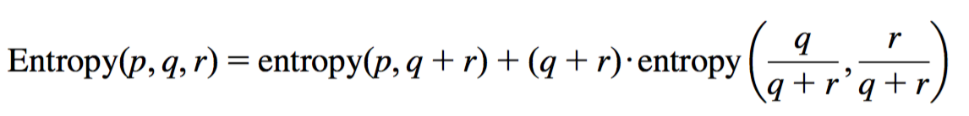
Divide-and-Conquer: Constructing Decision Trees
Entropy Calculation:
info([2,3,4]) = entropy(2/9, 3/9, 4/9)
Binary Logarithm
Multi-stage property:

Slide 12
Divide-and-Conquer: Constructing Decision Trees
Issue:
Termination only when all leaf nodes are pure (i.e. all have same classification)
Solution:
Termination when data can not be split any further

